Slide 1
Fragments Part 1
CS235AM
Android App Development
by Brian Bird
Spring 2016
Lane Community College

Slide 2
Course Schedule
Wk | Topic
1 | Intro + single-screen apps
2 | Multi-screen (multi-activity) apps
3 | Activity lifecycle and state
4 | List Views + Adapters
5 | Layouts + orientation
Wk | Topic
6 | Adapting to size and orientation: fragments
7 | Managing data: SQLite
8 | Consuming web services
9 | Geolocation
10 | Publishing to the Google Play Store

Slide 3
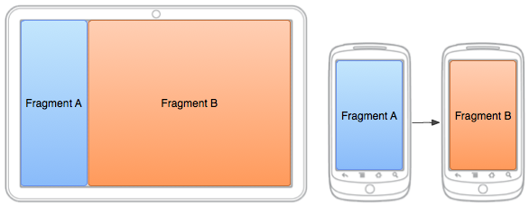
Android UI Fragments
Fragments allow apps to adapt to different screen sizes, densities, and orientations

Slide 4
Declaring a Fragment
An app will use fragments that are subclasses of Fragment
The Fragment’s UI can be declared in AXML or programmatically
Fragment UIs are declared just like Activity UIs

Slide 5
Loading a Fragment
Fragments are loaded into an Activity at runtime
The Fragment to load can be determined programmatically by the Activity’s C# code
Or the Fragment’s name can be hard-coded into the AXML loaded by the Activity

Slide 6
Process of Displaying a Fragment
Activity AXML layout: instantiates a Fragment object
Fragment object: inflates fragment AXML UI layout
Fragment AXML UI layout is displayed by the activity
Activity: loads an AXML layout

Slide 7
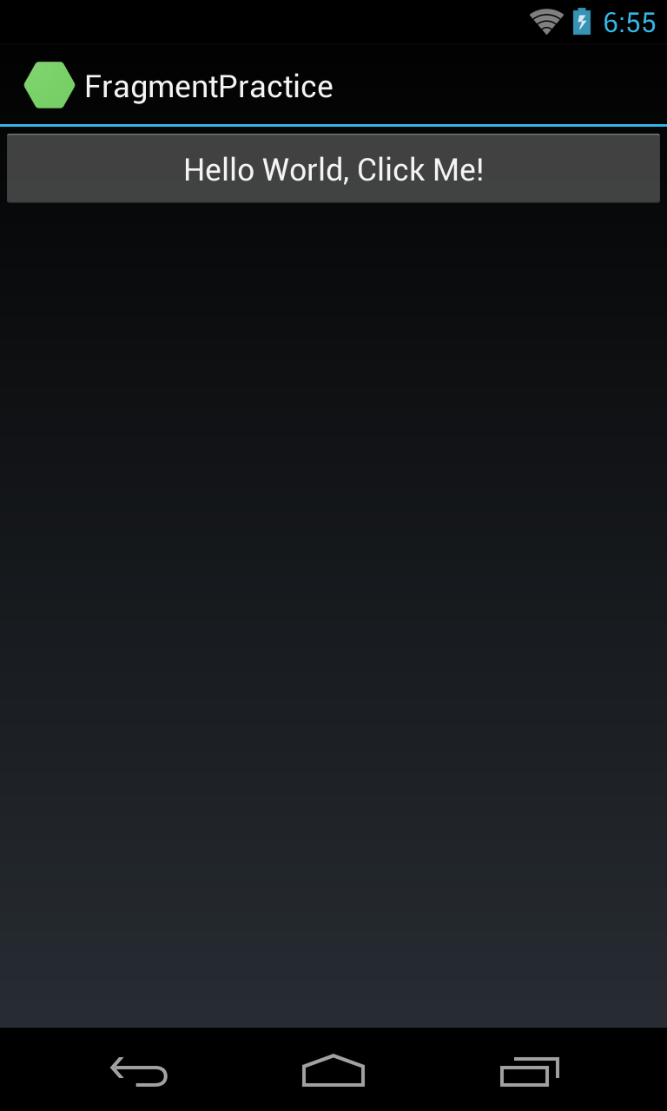
Example: Hello Fragment

Slide 8
Hello Fragment Example
We are just going to add one fragment to the Hello Android example so we can see how a Fragment is declared and loaded into an Activity
(Normally, to adapt to different screens, we would have two or more Fragments)

Slide 9
Implementing a Fragment
Steps to set up an Activity to use a Fragment:
Declare a Fragment class
Make an AXML UI layout for the fragment
Modify the AXML layout for the Activity so that it instantiates a Fragment object
Add code to inflate the UI in the OnCreateView method of the Fragment class

Slide 10
Declare a Fragment Class
Add a file to the project using the Android, Fragment template
Name the file HelloFragment.cs
public class HelloFragment : Fragment

Slide 11
AXML UI for the Fragment
Copy Main.axml and rename the copy: HelloFragmentUI.axml
You don’t need to change it’s contents!

Slide 12
AXML for the Activity
Main.axml will become just a container for a Fragment:
<?xml version="1.0" encoding="utf-8"?> <LinearLayout xmlns:android="http://schemas.android.com/apk/res/android" android:orientation="vertical" android:layout_width="match_parent" android:layout_height="match_parent"> <fragment android:name="FragmentPractice.HelloFragment" android:id="@+id/HelloFragment" android:layout_width="match_parent" android:layout_height="match_parent" /> </LinearLayout>

Slide 13
AXML Fragment Element
The attribute, android:name, specifies the Fragment class to load. Use the namespace and class name.
<fragment android:name="FragmentPractice.HelloFragment” android:id="@+id/HelloFragment” android:layout_width="match_parent” android:layout_height="match_parent" />

Slide 14
Next Session …
What you learned in this session isn’t useful by itself. You need to use two or more fragments to make an adaptive UI.
In Part 2, you will learn to use two fragments that will be loaded differently depending on the screen size.

